Slide 1
Area of Service Label Definitions (ASL)
Represents a previously-defined set of values for an Area of Service displayed on the CAD.
Allows a user to add, define, modify, and delete area of service labels of type:
- LATA
- NPA
- State
- NPA-NXX
SMS/800 ® is a registered trademark of SMS/800, Inc.
Notes:
Module 7 - ASL… Area Of Service Label Definitions
(Click)
An ASL is a previously defined set of values for Area of Service for the CAD.
(Click)
The ASL allows a user to add, define, modify and delete Labels and parts of labels for the following types:
(Click)
LATA
(Click)
NPA or Area Code
(Click)
State
(Click)
And NPA-NXX
(Click)

Slide 2
Label = “Shorthand” (2 Types)
LABEL
Shorthand
LAD
On CPR
“*” Required
CR specific
ASL
On CAD only
No “*”
Global
Notes:
An Earlier Module presented the LAD type of Label.
(Click)
Now we will look at the ASL type.
(Click)
They are different in the following ways:
(Click)
LAD goes on the CPR only. ASL goes on the CAD only.
(Click)
An Asterisk is the first character of a LAD. ASL requires no Asterisk.
(Click)
LAD is Customer record specific. To get a LAD into a different CR it must be copied. ASL is global. It becomes a table in the background of SMS/800. Anyone from the ENTITY can enter (Use) the ASL in their Resp Org’s Customer records by simply typing the name in the Label field of the CAD.
(Click)

Slide 3
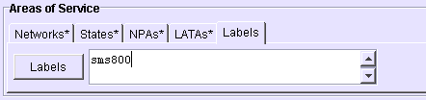
LAD Labels vs. ASL Labels
LAD Labels
Used as a shorthand for the CPR (defines how a call is routed)
Area of Service Labels (ASL)
Used as a shorthand for the CAD (defines who can call)
1 Name
Notes:
(Click)
Lad Labels are used as a shorthand way of entering values on the CPR
(Click)
(Click)
ASL Labels are a shorthand way of entering values on the CAD.
(Click)

Slide 4
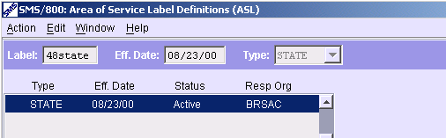
ASL - Label & Resp Org
STATE 08/23/10 Active ZAC01
LATA 09/24/10 Active ZAC01
NPA 10/10/11 Pending ZAC01
Label - A 3 to 7 alpha numeric name entered by a user.
Eff. Date -The effective date of the unit on display. Cannot be:
The same as the current date or prior.
The same date/type for an already existing unit.
Greater than one year in the future.
Type - Populated by the system with LATA, NPA, State, and NPA-NXX.
Status - Status of the record on display.
Resp Org - Responsible Organization
List of Units - Lists the different units for Label Name.
Notes:
To build an ASL label a user must access the ASL window.
(Click)
The Label Name must be a 3-7 alpha numeric name. Name must be unique because it is a table. It cannot be a name already in use.
(Click)
Eff. Date of the Unit one display. It cannot be: todays date, the same date/type for an existing unit. Cannot be greater than 1 year into the future.
(Click)
The Type designates one of the 4 types that can be created.
(Click)
Status is the status of the ASL unit on display.
(Click)
Resp Org – is the Responsible organization who built and uses this Label.
(Click)
List of Units is the list of all the Types and dates for this Label Name.
(Click)

Slide 5
ASL - Action Buttons
New Type | Adds a new Label Type.
Delete Unit | Deletes a unit after requesting verification.
Delete Type | Deletes a Label Type after requesting verification.
Copy Unit | Adds a unit to an existing label where the added unit contains the same data as the source unit.
Append Unit | Adds a unit to an existing label where the added unit is blank.
Notes:
The Action buttons on the ASL do the following:
(Click)
(Click)
New Type –
(Click)
Allows a user to add a new type to an existing label name. i.e. NPA
(Click)
Delete Unit –
(Click)
Deletes a Pending (future) unit
(Click)
Delete Type –
(Click)
Deletes all the future units of a particular type. (Append then Delete type)
(Click)
Copy Unit –
(Click)
Adds a unit where the copy contains the same data as the source.
(Click)
Append Unit –
(Click)
Adds a unit that is blank (first step of disconnecting a unit)
(Click)

Slide 6
How to View a list of current ASL Labels
1. Access the ASL window.
2. Select Menu Item “Action” and then “Get List of Key Values” or Ctrl +K
Notes:
(Click)
To view a list ASL labels already created by the Users in the Resp Org, the User would select the Action Menu dropdown and click “Get list of Key Values” or Press Ctrl+K.
(Click)

Slide 7
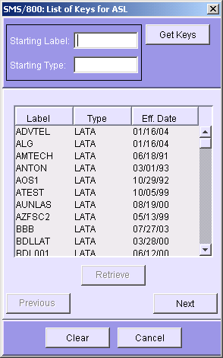
List of Keys for ASL
The List of Keys for ASL shows a list of Labels that have been created by and for your Resp Org only.
Select the Label from the list and Retrieve or double-click the Item in the list.
3. Starting search at Label and Type can be selected in the top fields.
Notes:
(Click)
1. The List of Keys for ASL shows a list of Labels that have been created by and for your Resp Org only.
(Click)
(Click)
2. Select the Label from the list and Retrieve or double-click the Item in the list.
(Click)
(Click)
3. Starting search at Label and Type can be selected in the top fields.
(Click)

Slide 8
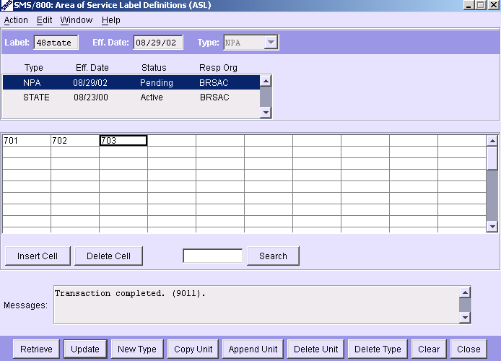
How to Define the First Unit for a New ASL Label
1. Enter a (Unique) Label name in the Label field.
2. Enter the Effective Date in the Eff. Date field.
3. Specify the type in the Type drop-down. i.e. NPA
4. Retrieve
5. Enter the values in the cells of the Definition Table.
6. Click the Update button.
Notes:
To Define the First Unit for a New ASL Label:
(Click)
Enter a (Unique) Label name in the Label field.
(Click)
2. Enter the Effective Date in the Eff. Date field.
(Click)
3. Specify the type in the Type drop-down.
(Click)
4. Retrieve
(Click)
5. Enter the values in the cells of the Definition Table.
(Click)
6. Click the Update button.
(Click)

Slide 9
How to Add a Unit to an Existing Label type
1. Select the unit from the List of Units field and press the Retrieve button.
2a. Press the Append Unit button if the new unit does not share many of the same values as the source unit.
2b. Press the Copy Unit button if the new unit does share many of the same values as the source unit.
3. Enter the effective date in the Eff. Date field.
4. Enter the information in the Definition Table fields.
5. Click the Update button.
Notes:
If you want to change a unit of a specific type. i.e. State
(Click)
1. Select the unit from the List of Units field and press the Retrieve button.
(Click)
2a. Press the Append Unit button if the new unit does not share many of the same values as the source unit. A blank screen will be displayed.
(Click)
2b. Press the Copy Unit button if the new unit does share many of the same values as the source unit. The new screen will contain the same data as the original.
(Click)
3. Enter the effective date in the Eff. Date field.
(Click)
4. Enter the information in the Definition Table fields.
(Click)
5. Click the Update button.

Slide 10
Delete a Pending Unit
1. Retrieve the Pending Unit.
2. Click the Delete Unit button.
3. Click the Yes button.
Notes:
To delete a Pending (future) unit:
(Click)
Retrieve the Pending unit
Click the Delete Unit button
Click the Yes button to confirm the delete.
(Click)

Slide 11
Delete a Type The way to disconnect an ASL
1. Copy/Append a Unit of the Type.
2. Enter Date. Click the Delete Type button.
3. Click the Yes button.
Notes:
Deleting a Type is the way to disconnect an ASL label. Each created type has to be deleted separately…
To Delete a Type…
(Click)
Copy or Append a Unit of the Type.
(Click)
2. Enter the Date for the Type to be deleted. Click the Delete Type button.
(Click)
3. Click the Yes button to confirm the deletion of the Type.

Slide 12
Create A NEW Type for an Existing Label Name
1. Enter the Existing Label Name in the Label field.
2. Press the Retrieve button.
3. Press the New Type button.
4. Enter the new information in the Eff. Date, Type, and Definition Table fields (cells).
5. Click the Update button.
Notes:
To add a NEW type for an existing Label… i.e. add an NPA to a label with just a STATE unit
(Click)
1. Bring up the ASL and Enter the Label Name in the Label field.
(Click)
2. Press the Retrieve button.
(Click)
3. Press the New Type button.
(Click)
4. Enter the new information in the Eff. Date, Type, and Definition Table fields (cells).
(Click)
5. Click the Update button.
(Click)

Slide 13
ASL - Types and Units
A Type (I.E. State) can consist of many Units (I.E. Effective Dates).
The earliest date a new Unit can become Active is Tomorrow. Latest = 1 year.
The most recent (Active) Unit will be attached to a CR whenever a CR is newly created or copied and updated.
ASLs can be used on any CR under the same Resp Org only.
One Name can consist of all four Types with their corresponding Units.
Notes:
Helpful facts about ASL Types and Units…
(Click)
1. A Type (I.E. State) can consist of many Units (I.E. Effective Dates).
(Click)
2. The earliest date a new Unit can become Active is Tomorrow. Latest = 1 year.
(Click)
3. The most recent (Active) Unit will be attached to a CR whenever a CR is newly created or copied and updated.
(Click)
4. ASLs can be used on any CR under the same Resp Org only.
(Click)
5. One Name can consist of all four Types with their corresponding Units.
(Click)

Slide 14
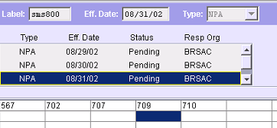
ASL – Names/Types/Units
LATA 10/10/10 Active ZAC01
STATE 10/10/10 Active ZAC01
NPA 10/10/10 Active ZAC01
NPA 11/11/11 Pending ZAC01
Example:
One Name (sms800) with 3 Types (Lata, State, NPA ) The NPA Type has 2 Units (one pending for a future Date 11/11/11).
Notes:
Let us look at a specific use of Names/Types and Units.
(Click)
One Name (sms800)
(Click)
with 3 Types (LATA,State, NPA )
(Click)
The NPA Type has 2 Units (one pending for a future Date).
(Click)(Click)
Whenever a CAD was/is built or updated between 10/10/10 and 11/11/11 the AOS will be determined by the 3 ACTIVE units.
(Click) (Click)
(Click) (Click)
On 11/11/11 the Pending unit will become ACTIVE. After 11/11/11 whenever a CAD is newly created or updated that contains the AOS label, the AOS will be defined by the new active NPA unit along with the ACTIVE LATA and STATE units.

Slide 15
AIR (ASL Label Inquiry Request)
The AOS Label Inquiry Request (AIR) is used to request a report showing all Customer Records that contain a specific ASL label.
The WRS system generates the report data overnight and stores it for 14 days.
A system mail message or email serves as the notification method when the report is ready.
Email notification is sent to the email address defined for the user’s logon id via the ROP screen.
The report is initiated using WBA. The report is viewed using the WRS. (Area of Service to Dial# Report is used to view the results of this request)
1 Name
Notes:
The AIR (ASL label Inquiry Request screen) is used to:
(Click)
1. Request a report showing all Customer Records that contain a specific ASL label.
(Click)
2. The WRS system generates the report data overnight and stores it for 14 days.
(Click)
3. A system mail message or email serves as the notification method when the report is ready.
(Click)
4. Email notification is sent to the email address defined for the user’s logon id via the ROP screen.
(Click)
5. The report is initiated using WBA. The report is viewed using the WRS. (Area of Service to Dial# Report is used to view the results of this request)

Slide 16
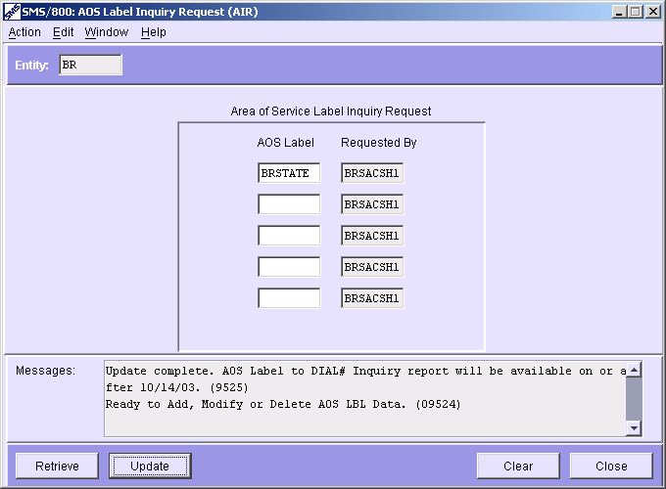
AIR Screen
Request a report for up to 5 labels
Notes:
The AIR screen allows the User to request a report for up to 5 Labels.
(Click)

Slide 17
Area of Service to Dial# Report
Report run in WRS remains in WRS 1-14 days after requested on AIR
1 Name
Notes:
The Report in WRS looks like this.
(Click)
The “Area of Service to Dial# Report” will remain in WRS for 14 days after requested on the AIR.
(Click) (Click)
The results will show the list of Dial Numbers and the Extract Date (When the data was pulled from WBA to the WRS.

Slide 18
Routing Guam, Saipan, Samoa -1
Listing Canada as part of the Area of Service for a CAD allows Guam calls to complete. Blocking Guam/Saipan/Samoa calls may require alternative CAD Area of Service setup.
The general guidelines for routing GUAM/SAIPAN/SAMOA are as follows:
If you are going to route (or block) the Specific Guam/Saipan/Samoa NPAs (670,671,684) or LATAs (870,871,884) on the CPR, you have 2 options.
Use XA, XC or CN in the Area of Service of the CAD. Then route or block them on the CPR.
List them specifically on the CAD for Area of Service.
a) Having listed them specifically on the CAD, you then are not allowed to use the (Mutually Exclusive) Network Codes of US, XA, XB or XC. A workaround is to setup the CAD Area of Service as demonstrated on the next slide:
1 Name
Notes:
Guam, Saipan and Samoa may require special AOS setup…
(Click)
Listing Canada as part of the Area of Service for a CAD allows Guam calls to go through. Blocking Guam/Saipan/Samoa calls may require alternative CAD Area of Service setup.
(Click)
The general guidelines for routing GUAM/SAIPAN/SAMOA are as follows:
If you are going to route (or block) the Specific Guam/Saipan/Samoa NPAs (670,671,684) or LATAs (870,871,884) on the CPR, you have 2 options;
(Click)
Include Canada, Use XA, XC or CN, in the Area of Service of the CAD. Then route or block them on the CPR.
(Click)
2. List them (Latas or NPAs) specifically on the CAD for Area of Service.
However… Having listed them specifically on the CAD, you then are not allowed to use the (Mutually Exclusive) Network Codes of US, XA, XB or XC. A workaround is to setup the CAD Area of Service as demonstrated on the next slide:
(Click)

Slide 19
Routing Guam…2
CAD Area of Service desired is USA, Caribbean and Guam/Saipan/Samoa. (NOT Canada)
Networks = CR (Carribbean)
LATAs = 870, 871, 884 (Guam, Saipan, Samoa)
Labels = (ASL label name with all States in it)
1 Name
and
and
884
Caribbean (CR) on Network tab
870, 871, 884 on Lata Tab
50 state label on Labels tab
Notes:
(Click)
If CAD Area of Service desired is USA, Caribbean and Guam/Saipan/Samoa. (NOT Canada) (See Guam Routing Guide Section 3.6)
Set up the CAD Area of Service in the following way:
(Click)
Networks = CR (Carribbean)
(Click)
LATAs = 870, 871, 884 (Guam, Samoa, Saipan)
(Click)
Labels = (Use an ASL label name that contains all States)

Slide 20
Module 07 Review
ASL Definition
ASL Window
ASL Tasks
Written Exercise ASL #8
Hands-On Exercises ASL (8A–8C)
Notes:
Please complete the Written and Hands On exercises for Module 7 ASL.

